Slide 1
VI Semester
Lecture: 20 March 2020
Subject: Community Medicine
Chapter: Epidemiology
Topic: Measurements in Epidemiology
Faculty: Dr. A. K. Sharma
Note: Click on the audio link on each slide to listen to the lecture

Slide 2
Measurements in epidemiology
Morbidity
Mortality
Disability indicators
Natality indicators
Service indicators
Operations indicators
Process indicators
Impact indicators
Summary measures of population health

Slide 3
Incidence rate & proportion
Incidence rate: units/person-time
Incidence proportion/cumulative incidence: units/population at risk
Incidence proportion=I∆t (incidence density) if t is very small
Case fatality rate or case fatality ratio is a type of incidence proportion

Slide 4
Prevalence
Prevalence rate: p/N
Prevalence odds: p/N-p
Prevalence odds=incidence rate * mean duration
If p « N; p/N ≈ p/N-p
In such situations,
p/N=i*D

Slide 5
Measurements in epidemiology
Mortality:
Crude Death Rate,
Age specific death rate,
Disease specific death rate,
Case fatality rate
Standardization of mortality rates
Standardized Mortality Ratio
Direct standardization

Slide 6
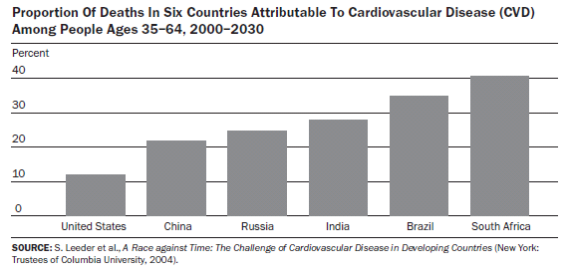

Slide 7
Leading Causes of Mortality World, 2004
Mortality
%
Ischaemic heart disease 12.2
Cerebrovascular disease 9.7
Lower respiratory infections 7.1
COPD 5.1
Diarrhoeal diseases 3.7
HIV/AIDS 3.5
Tuberculosis 2.5
Trachea, bronchus, lung cancers 2.3
Road traffic accidents 2.2
Prematurity, low birth weight 2.0

Slide 8
CAUSE SPECIFIC MORTALITY ESTIMATION INDIA-2005

Slide 9
Japanese encephalitis: India
Year | Cases | Deaths | CFR
2007 | 4110 | 995 | 24.2
2008 | 3839 | 684 | 17.8
2009 | 4482 | 774 | 17.2
2010 | 5167 | 679 | 13.1
2011 | 8249 | 1169 | 14.2
2012 | 2260 | 458 | 20.2

Slide 10
Measurements in epidemiology
Disability indices:
Disability Adjusted Life Years
Quality Adjusted Life Years
Natality indicators:
Age Specific Fertility rate
Total Fertility Rate
Gross Reproduction Rate
Net Reproduction Rate

Slide 11
Leading Causes of Mortality and Burden of Disease world, 2004
Mortality
DALYs
%
Ischaemic heart disease 12.2
Cerebrovascular disease 9.7
Lower respiratory infections 7.1
COPD 5.1
Diarrhoeal diseases 3.7
HIV/AIDS 3.5
Tuberculosis 2.5
Trachea, bronchus, lung cancers 2.3
Road traffic accidents 2.2
Prematurity, low birth weight 2.0
%
Lower respiratory infections 6.2
Diarrhoeal diseases 4.8
Depression 4.3
Ischaemic heart disease 4.1
HIV/AIDS 3.8
Cerebrovascular disease 3.1
Prematurity, low birth weight 2.9
Birth asphyxia, birth trauma 2.7
Road traffic accidents 2.7
Neonatal infections and other 2.7

Slide 12
Measurements in epidemiology
Natality: GRR, NRR, Age Specific Fertility rate
Service indicators
Operations indicators
Process indicators
Impact indicators
Summary measures of population health

Slide 13
General fertility rate (GFR):
GFR= Number of live births in an area
during the year
Mid-year female population age (15-44) in the same area in the same year

Slide 14
Age specific fertility rate (ASFR):
ASFR=Number of live births
in a particular age group *1000
Mid year female population
of the same age group

Slide 15
Total fertility rate(TFR):
It represents the average number of children a woman would have if she were to pass through her reproductive years bearing children at the same rates as the women now in each group
TFR (India )=2.76
(kerala)=1.7

Slide 16
Total Fertility Rate
Disadvantages:
TFR is a synthetic measure; no individual woman is very likely to pass through three decades conforming to the age-specific fertility rates of any single year. In reality, age-specific rates change and fluctuate from year to year, even if only gradually.
year-to-year fluctuations in the TFR may reflect changes in the timing of births rather than changes in the average number of children women bear, For example, women who were ages 15-19 in 2003 may delay childbearing longer than women ages 15-19 in, say, 1990. They would lower the TFR a bit in 2003 but then raise it several years later when they begin their childbearing

Slide 17
Calculating TFR

Slide 18
Measurements in epidemiology
Service indicators: Bed utilization rate, Immunization coverage rate,
Operations indicators: Man days lost, time utilization rate, Waiting time
Process indicators: Operations performed, children immunized,
Impact indicators: Deaths averted, infections prevented, births prevented
Summary measures of population health

